Slide 1
Reading at Lydgate Infant School
Year 1

Slide 2
What is reading?
Comprehension
(skill)
Motivation
(experiences)
Word-reading
(skill)

Slide 3
How we teach reading at school
Phonics (Letters and Sounds)
Guided Reading
Story time
English lessons
1:1 reading
Whole Class reading
Library visits
Home/School Reading diary

Slide 4
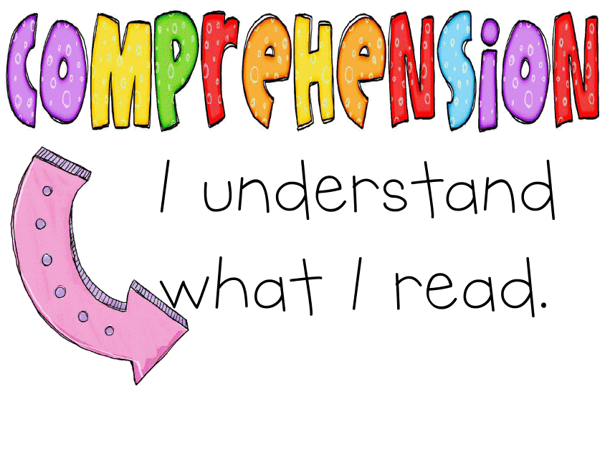
Comprehension
The aim of reading is comprehension.
Written language is different from spoken language. We need to support children to help them learn to comprehend what they read.
Children who enjoy reading and choose to do this regularly do better at GCSE.

Slide 5
Fluency
Read aloud fluently, showing understanding of what they read.
Accurate word-reading
Pausing at punctuation (and recognising what the punctuation tells us)
Good expression (which matches the mood of the text)

Slide 6
Literal and inferential comprehension
Discussing what we know from what is written down and what is being inferred from the chosen vocabulary.
The boy wandered through the wood munching on his green, juicy apple.
What is the boy eating?
How does the boy feel? How do you know?

Slide 7
Summarizing
Discuss what they have read in their own words.
Recall the important information.
Keep it short.
Reminder of what has been read so far.
This part was about …
First, ….. Next, …. Then, …
This story takes place in …
The main characters are …
The problem of the story is …

Slide 8
Questioning
Ask questions to help understand what has been read.
Think of questions to ask as they read the text.
Who…
What…
When…
Why…
Where…
How…
What if…

Slide 9
Clarifying
It is important to clarify when…
You read a word you don’t understand.
Find that a sentence does not make sense.
Are confused by what you have read.
Children should be given opportunities to explain and say what they think it means. Take time to find out the meaning of unknown vocabulary / phrases.

Slide 10
Predicting
Use what you have read or clues from the illustrations to help figure out what will happen in the text.
This could be related to familiar stories that children know.
Predictions can change as you read on!
I think ….
I wonder if …
I imagine …
I suppose …
I predict …
I think this text will be about…

Slide 11
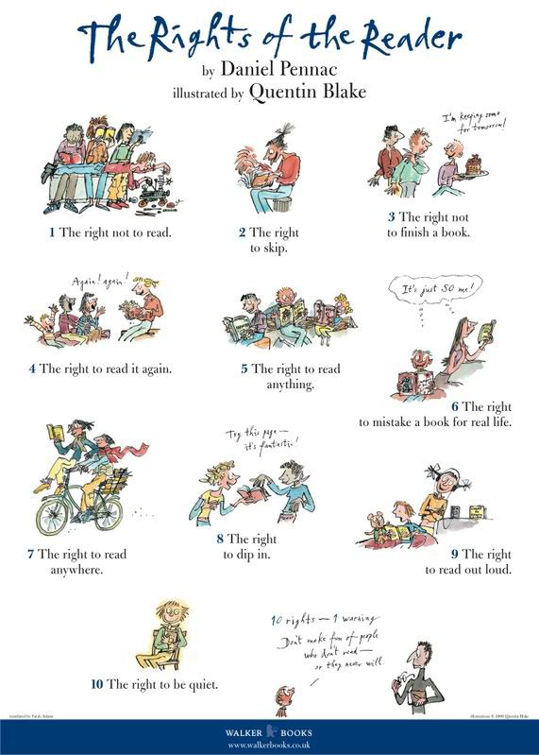

Slide 12
Book Bands
Goldilocks Principle – not too easy, not too hard, just right
Children need to understand what they are reading.
We assess the children to decide when they need to move on.
If you think your child is ready to move on. Talk to your child’s teacher – they may agree or you may have a useful discussion about your child’s current gaps.
End of F2: Red/Yellow
End of Y1: Orange/Turquoise
End of Y2: Gold/White
Readings books to take home – not all decodable

